Slide 1
THE CURRENCY CONVERTER
Project Title

Slide 2
What will a Currency Converter Do
A currency converter project is a tool designed to convert the value of one currency into another based on current exchange rates.
Users can input an amount in a specific currency, select the desired target currency, and the converter will provide the equivalent value

Slide 3
How Actually a Currency Conversion Tool works
Currency conversion Project typically involves fetching real-time exchange rate data and implementing a user-friendly interface for seamless currency conversion.
the process of fetching real-time exchange rate data involves connecting to external financial data sources or APIs (Application Programming Interfaces)
This provide up-to-date information on currency exchange rates.

Slide 4
our project ‘THE CURRENCY CONVERTER’
This project is a personal currency conversion assistant, built in Python!
It lets you easily switch between Indian rupees and various foreign currencies, based on an average exchange rates over the past year(2023)
Programming Language : | Python
Tool : | Google Colab
Link of Source code : | https://colab.research.google.com/drive/1rzAapK-bXAk2rG-uZKZrsCidO83Uolta

Slide 5
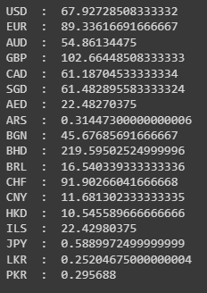
How ‘THE CURRENCY CONVERTER’ Works
We've built a special dictionary containing average exchange rates for different currencies against the Indian rupee.
Each currency code is the key (like USD or EUR), and the value tells you how much one unit of that currency is worth in rupees.
Simply tell the program , It Easily convert both INR to other currencies and other currencies to INR
Key : Currency Code
Value : one unit of corresponding
currency in Indian Rupees

Slide 6
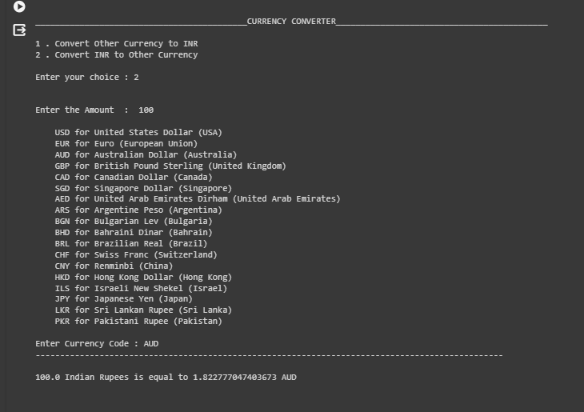
Screenshot of Output

Slide 7
Conclusion
This project successfully facilitates the conversion of Indian Rupees to other currencies and vice versa, leveraging average exchange rates from the past year (2023).
However, it has limitations, such as the absence of real-time exchange rates and the ability to convert only between INR and other currencies, not among different foreign currencies.

Slide 8
Thank You

